Slide 1

Storage Locations of Website Security Tokens in Browsers

Slide 2

Security tokens for websites (like JWTs, session cookies, OAuth tokens, or CSRF tokens) are typically stored in the browser in one of these main places, depending on how the site implements authentication:

Slide 3
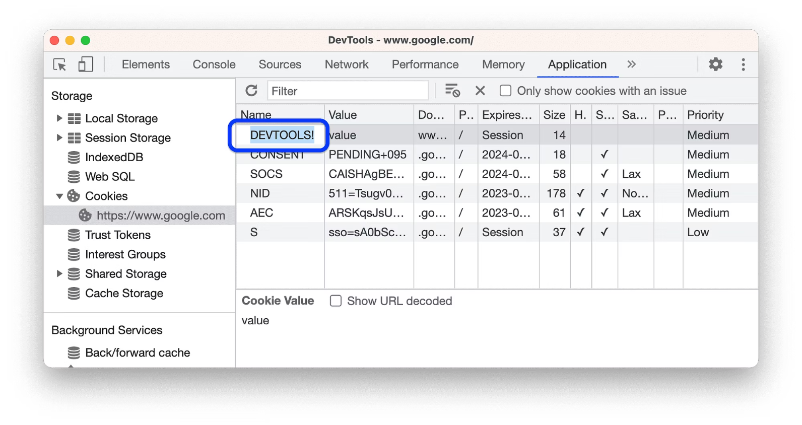
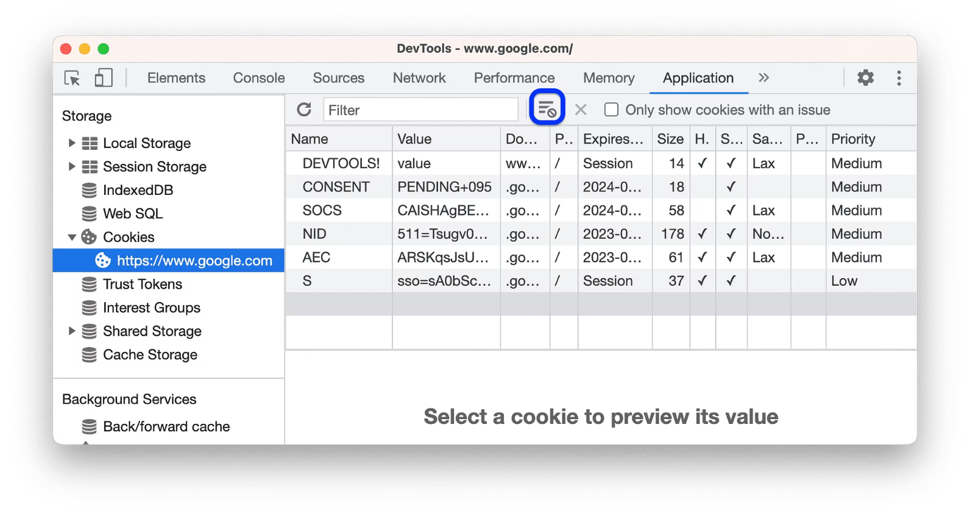
Cookies (most common for session tokens)
Stored in the browser's cookie jar, accessible via document.cookie in JavaScript. They're sent automatically with HTTP requests to the same domain.
Check them in DevTools under Application > Cookies (Chrome/Edge) or Storage > Cookies (Firefox).
Sensitive ones often have HttpOnly (blocks JS access), Secure (HTTPS only), and SameSite flags.

Slide 4
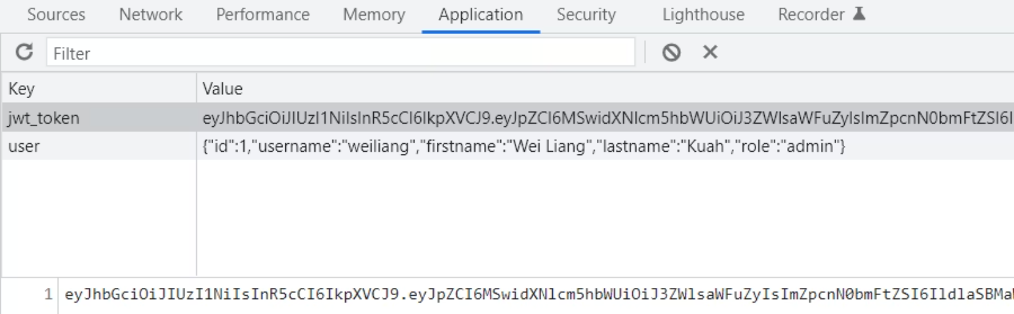
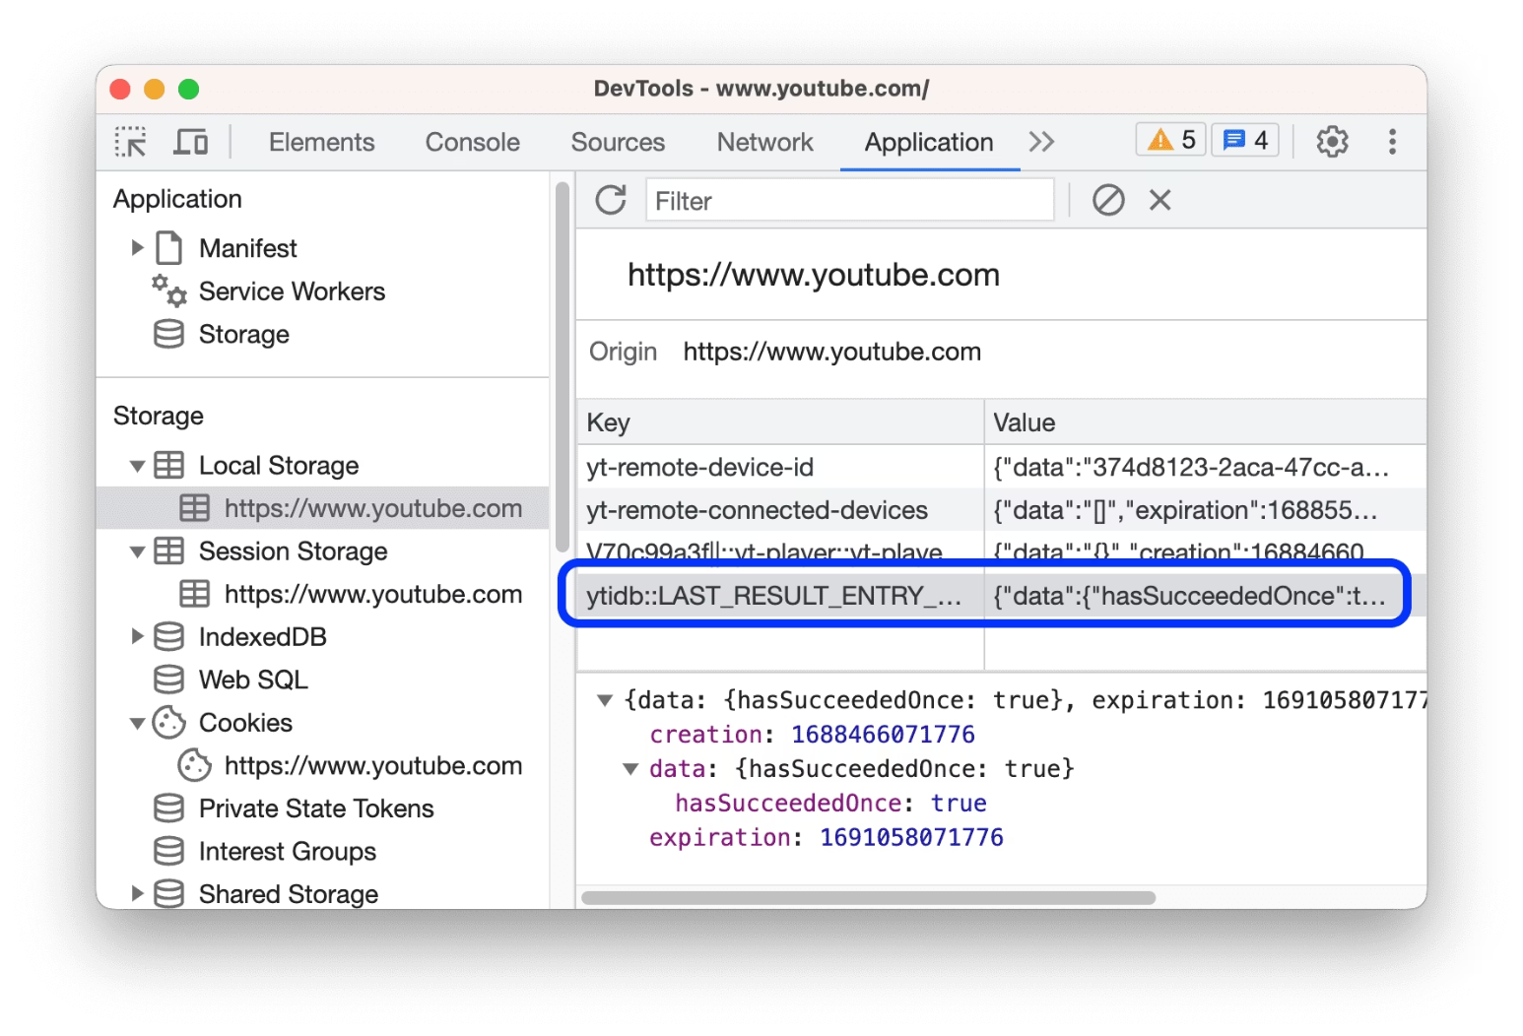
LocalStorage or SessionStorage
Stored as key-value pairs in the browser's Web Storage API. Easily accessible via localStorage.getItem('token') or sessionStorage.getItem('token') in the console.
LocalStorage persists across sessions; SessionStorage clears on tab close.
View in DevTools: Application > Local Storage or Session Storage.

Slide 5
IndexedDB
For larger or structured token data, stored in a client-side database. Access via indexedDB API.
Less common for simple tokens but used in SPAs.
Check DevTools: Application > IndexedDB.

Slide 6
Memory (in-memory)
Some single-page apps (SPAs) keep tokens only in JavaScript variables during the session, never persisted.
These vanish on page refresh inspect variables in DevTools Sources > Scope or console.

Slide 7
To enumerate during pentesting:
// Cookies
console.log(document.cookie);
// Local/Session Storage
Object.entries(localStorage).forEach(([k,v]) => console.log(k,v));
Object.entries(sessionStorage).forEach(([k,v]) => console.log(k,v));

Slide 8

Always check Network tab in DevTools for Authorization: Bearer <token> headers, reveals API tokens not stored in standard locations.

Slide 9

Common Names Used for Security Tokens in a Website

Slide 10
Security tokens can be named almost anything, but in real projects you'll see certain patterns again and again.
These naming conventions is crucial for security testing, debugging, and implementation. Let's explore the most common patterns you'll encounter across different authentication systems.

Slide 11

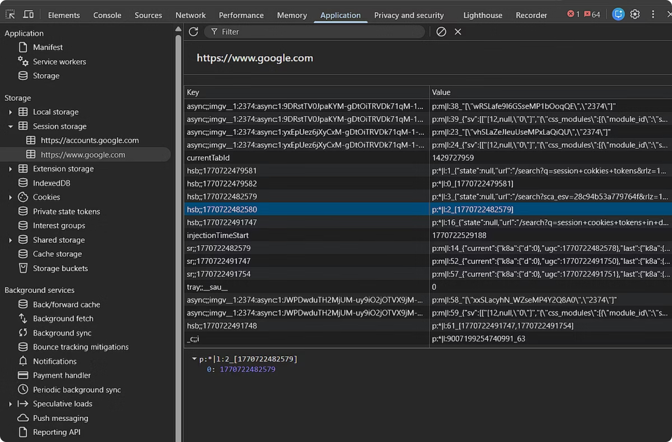
Session/Cookie Tokens
Server-side sessions
PHPSESSID
JSESSIONID
ASP.NET_SessionId
SESSIONID
session_id
sid
sess_id

Slide 12
JWT/Bearer Tokens
API auth, often in localStorage or headers
token
access_token
id_token
auth_token
bearer_token
jwt
idtoken

Slide 13
OAuth/OpenID Connect
OAuth/OpenID Connect
accessToken
idToken
refresh_token
authorization_code
code
Modern authentication protocols used across the web

Slide 14






CSRF Tokens
Anti-CSRF protection
csrf_token
_token
authenticity_token
xsrf_token
XSRF-TOKEN
__RequestVerificationToken

Slide 15
SAML/Enterprise SSO
SAML/Enterprise SSO
SAMLResponse
RelayState
Enterprise single sign-on authentication tokens used in corporate environments
saml_token
saml_assertion

Slide 16
App-Specific/Common SPA Patterns
userToken
apiKey
api_token
auth
user_session
login_token

Slide 17
Quick enumeration commands
Run in browser console
// Scan storage for token-like keys
[...localStorage, ...sessionStorage].filter(k => k.match(/token|auth|sess|csrf|jwt|bearer/i)
).forEach(k => console.log(k, eval(k))); // eval for local/sessionStorage
// Headers in Network tab: Authorization, X-Auth-Token, X-API-Key
During pentests, grep responses for these patterns too grep -i "token\|auth\|sess\|jwt" response.html. Many sites use predictable prefixes like app_ or _app. Check robots.txt/sitemap.xml for admin panels that expose auth endpoints.

Slide 18

Parameters used to generate token

Slide 19

Token generation parameters vary by type, but here are the most common inputs/claims used across authentication systems.
Security tokens aren't random strings. They're generated using specific inputs (claims + metadata + secrets). What's used depends on the token type (JWT, session ID, OAuth token, etc.).
These are what servers typically require or embed when creating tokens:

Slide 20

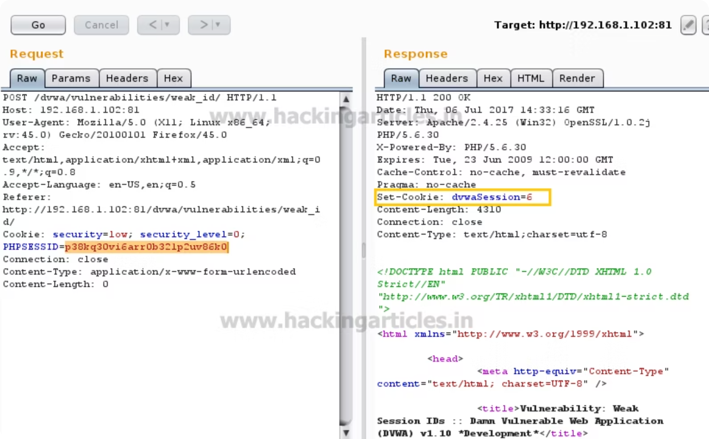
Session ID Tokens
(PHPSESSID, JSESSIONID)
user_id
login_timestamp
(or session_user_id)
session_expiry
ip_address
hmac_signature
user_agent
(server-side secret + data)

Slide 21



JWT Tokens
(JSON Web Tokens)
Header (always)
Payload Claims (core params)
Custom Claims (app-specific)
alg: HS256/RS256 (signature algo)
typ: JWT
kid: key_id (for key rotation)
sub: user_id/email
iat: issued_at (timestamp)
exp: expires_at (timestamp)
nbf: not_before (timestamp)
iss: issuer
aud: audience
jti: jwt_id (unique)
user_id, username, email, roles, permissions, tenant_id
scope, client_id (OAuth)
refresh_token_id, device_id, ip_address

Slide 22
OAuth 2.0 Tokens
grant_type: authorization_code/password/refresh_token
client_id, client_secret
code: auth_code (from /authorize)
redirect_uri
scope: read write profile email
state: CSRF protection
user_id, username, password (resource owner flow)

Slide 23


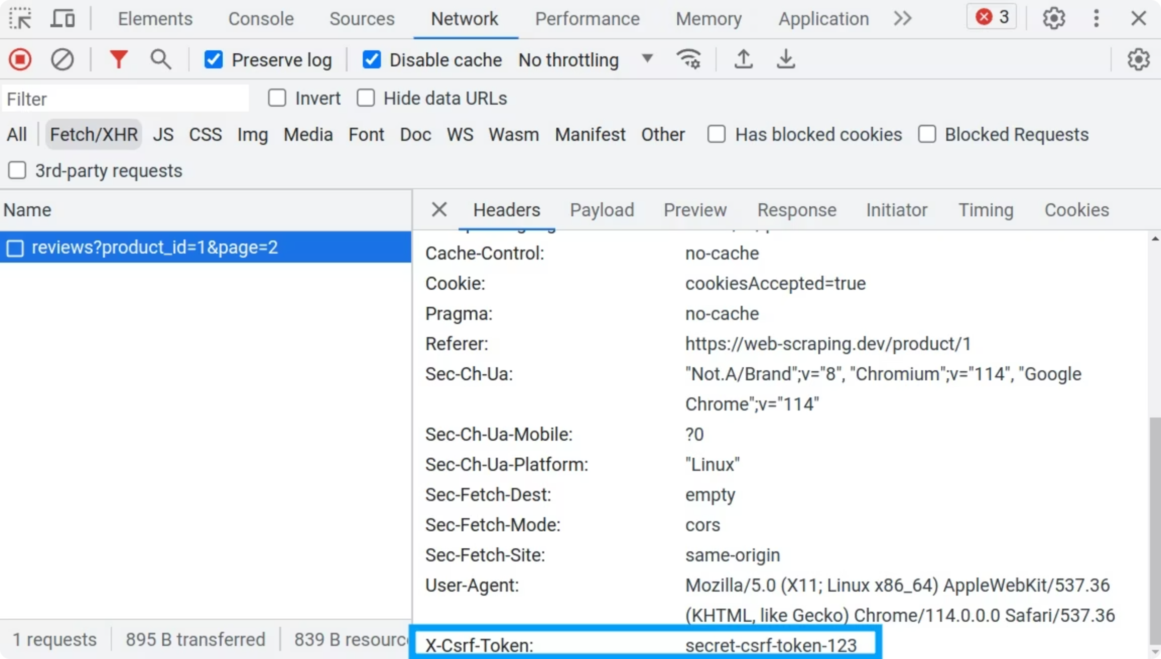



CSRF Tokens
session_id
(links to user session)
timestamp
random_salt/entropy
(32-64 bytes)
hmac
(user_id + timestamp + secret)

Slide 24


API Keys
api_key_id
user_id/owner_id
scopes/permissions
created_at, expires_at
(prefix like sk_live_xxx)
hmac
(api_key_id + secret)

Slide 25
Enumeration during pentests
Decode JWTs to inspect claims
# Decode JWTs to inspect claims
echo "eyJ..." | base64 -d | jq . # Linux
jwt.io # Online decoder
# Common token gen endpoints to fuzz
POST /api/login {username, password}
POST /api/auth/token {client_id, client_secret, grant_type}
POST /oauth/token {code, redirect_uri}
Weakness patterns
Predictable iat/exp → token replay
Missing nbf → early use
Weak kid → key confusion
Reused jti → token reuse
These params are often logged in server access logs or exposed in misconfigs—check /var/log/apache2/access.log if you get shell.

